Slide 1
Financial Analytics HS302
With STATA software

Slide 2
Content
Module: 1- Fundamentals statistical properties of Financial Variables (Unit root, stationarity, MRP etc.)0
Module: 2- Univariate Analysis (AR I MA) model and prediction of Stocks
Module:3- Multivariate Analysis, VAR model, Impulse response model and Global Financial Market Integration
Modue:4- Modeling Volatility of Stocks and markets (ARCH, variants of GARCH models)
Module:5- Random Walk model, Stock and Option pricing and strategies, Introducing Behavioural Finance and its recent trend

Slide 3
Evaluation
Quiz- 1 (10%)
Midsem (25%)
Quiz-2 (10%)
Individual Assignment -(15%)
Group Presentation (15%)
Endsem (25%)

Slide 4
Investment Horizon
Intraday trading
Short term (2 days to quarter 3-4 months)
Medium term (3-4 months- 1 Year)
Long term (Above 1 Year)

Slide 5
Fundamental Analysis
Analyzing News and Information about the Stock/ market etc.
Economic and Geopolitical factors…

Slide 6
Macroeconomics Analysis
Global Economy Analysis
affects export, price competition and profits
exchange rate: purchasing power and earnings
Domestic Economy
The ability to forecast the macroeconomy can translate into great investment performance
outperform other analysts to earn extra profits Many variables can affect economy

Slide 7
Gross Domestic Product (GDP): measures the economy’s total output of goods and services
Employment rate: measures the extent that the economy is operating at full capacity
Inflation measures the general level of prices increase Phillip’s curve
Interest Rate high interest rate reduces PV of cashflows, thus stock values
Budget Deficit large deficit means more borrowing, which implies higher interest rate.
Sentiment consumers and producers confidence

Slide 8
Business Cycles
business cycles: pattern of recession and recovery
peak: the end of expansion and start of recession
trough: the bottom of the recession
stock returns are decreasing when at peak and increasing at trough
cyclical industries: do well in expansionary periods but poorly in recession, e.g., durable goods such as automobile and wash machines
defensive industries: little sensitive to business cycles, such food

Slide 9
Industry Analysis
Select a good industry to invest. It is difficult for a firm to do well in a troubled industry
Two factors that determine the sensitivity of a firm’s earnings to business conditions: business risk, financial risk

Slide 10
P/E ratio
The Price Earnings Ratio (P/E Ratio) is the relationship between a company’s stock price and earnings per share (EPS). It is a popular ratio that gives investors a better sense of the value of the company. The P/E ratio shows the expectations of the market and is the price you must pay per unit of current earnings (or future earnings, as the case may be)

Slide 11
Du Pont Analysis
Return on Equity ROE=NPM×Asset Turnover×Equity Multiplier
NPM=Net profit margin, the measure of operatingefficiency
Asset Turnover=Measure of asset use efficiency
Equity Multiplier=Measure of financial leverage​
ROE=(Net Income/Sales )​×(Sales​/Assset)×(Asests/Shareholders’ Equity)

Slide 12
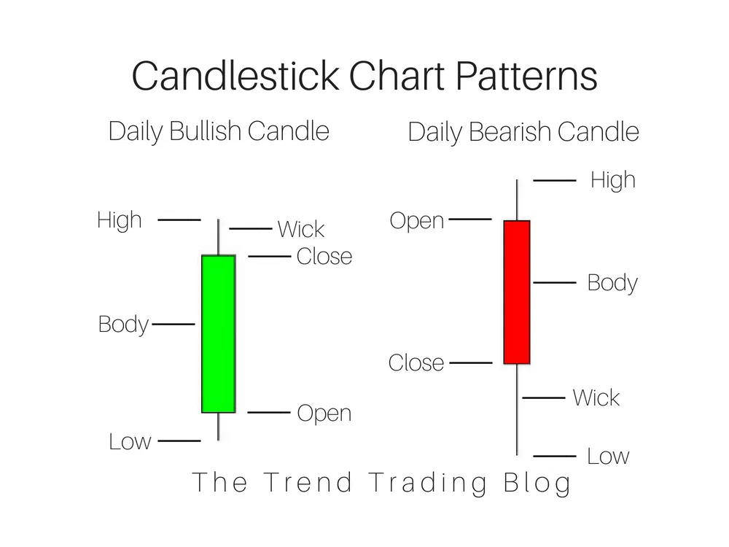

Slide 13
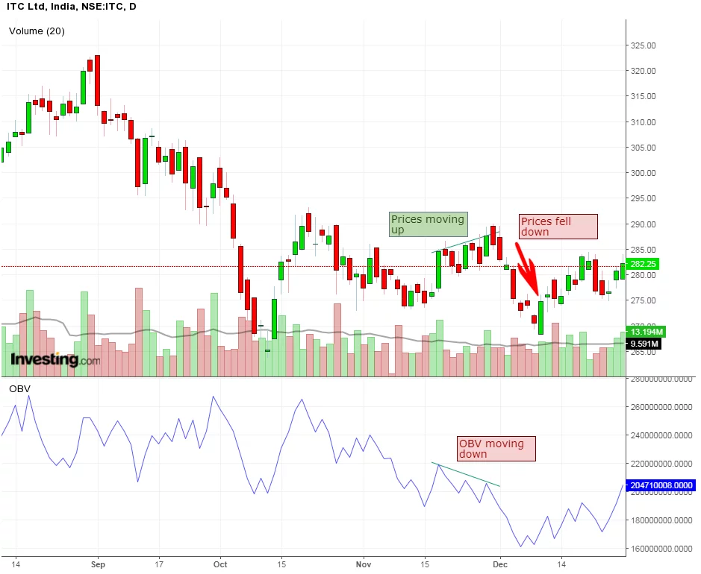
Technical Analysis
The On-Balance-Volume indicator (OBV)
Positive or negative volume of a stock
Current OBV = Previous OBV + today’s volume

Slide 14
The Accumulation/Distribution line (A/D line)
(close – low) – (high – close) / (high – low)
If the security’s price is in a downtrend while the accumulation/distribution line is in an uptrend then the indicators show that there may be buying pressure and the prices may reverse.

Slide 15
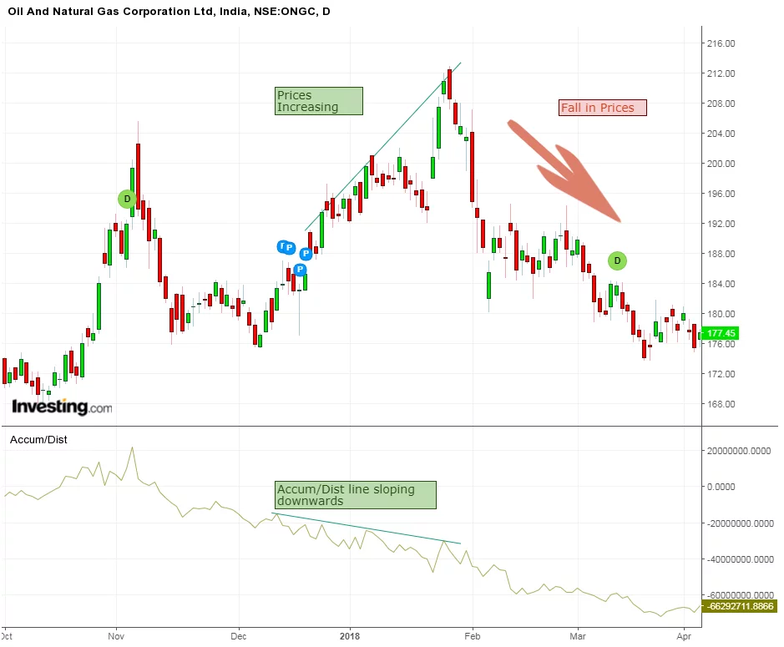
We can see from the above daily chart of ONGC that the prices were in an uptrend whereas the accumulation/distribution line was sloping downwards which showed the selling pressure in ONGC and prices eventually reversed and the trend became bearish

Slide 16
The Average Directional Index (ADX)
The Average Directional Index (ADX) is used to assess when the price is trending strongly. ADX calculations are based on a moving average of price range expansion over a period of time. The default setting is 14 bars.

Slide 17
Aroon
It is used to identify when trends are likely to change direction. This indicator measures the time it takes for the price to reach the highest or lowest points over a particular timeframe
Aroon Up – ((N – Days Since N-day High) / N) x 100
Aroon Down – ((N – Days Since N-day Low) / N) x 100

Slide 18
There are three stages in order to identify an uptrend signal:
Firstly the Aroon lines will cross. The upward signal is when Aroon-Up moves above Aroon-Down. This shows that new highs are becoming more recent than new lows.
Secondly the Aroon lines will cross above or below 50.
Thirdly one of the lines will reach 100. Aroon up reaches 100 and Aroon down remains at low levels.

Slide 19
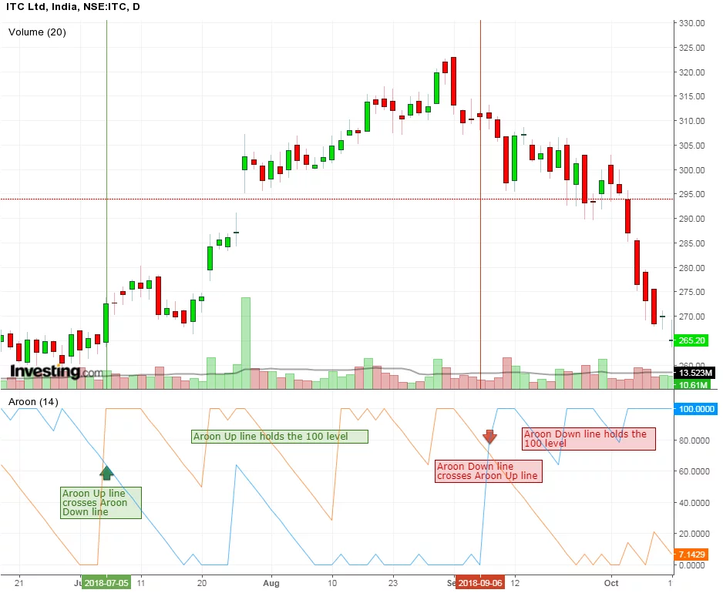

Slide 20
Moving Average Convergence Divergence (MACD) Indicator
Step1. Calculate a 12-period exponential moving average of the close price.
Step2. Calculate a 26-period exponential moving average of the close price.
Step3. Subtract the 26-period moving average from the 12 periods moving average. This is the fast MACD line.
Step4. Calculate a 9-period exponential moving average of the fast MACD line calculated above. This is the slow or signal MACD line.

Slide 21
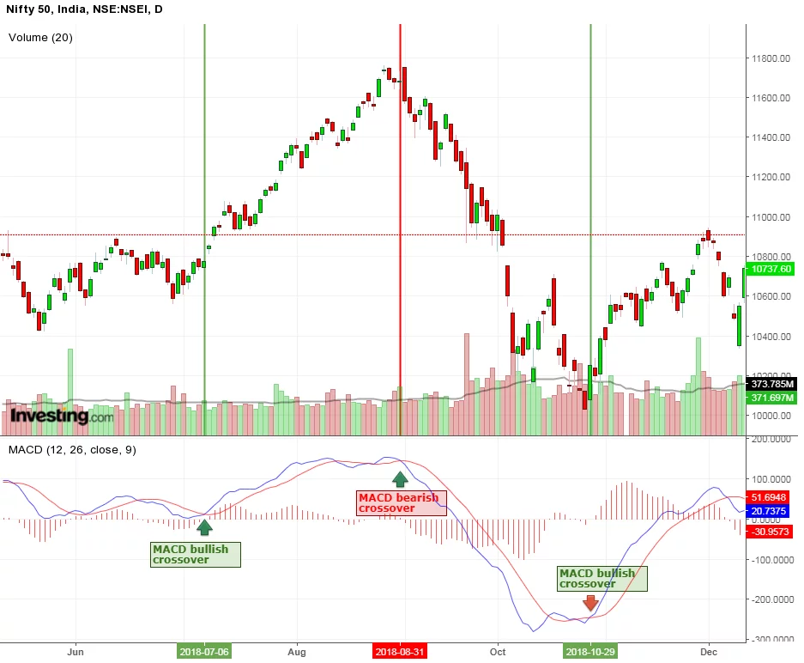

Slide 22
Long Term Time Series Analysis of Stocks
Concept of Stationarity
1) It should be MV (Mean Reverting)
2) It should have constant and time independent
variance
3) It should have time-invariant covariance at any time lag

Slide 23
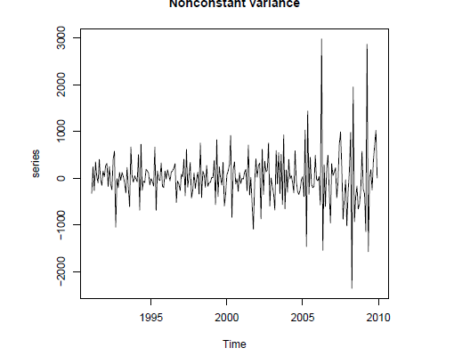
Variance is changing

Slide 24
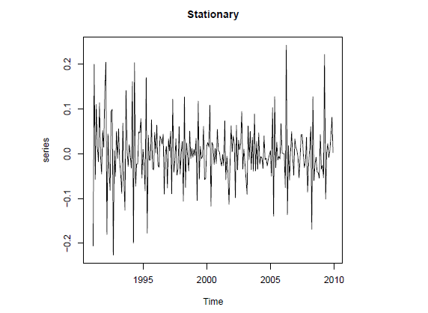

Slide 25
Concept of Regression Line
Y | X
10 | 1
12 | 3
14 | 6
8 | 2
7 | 4
11 | 7
13 | 9
18 | 12
19 | 13

Slide 26
Linear Fit
Y = a + b X
This is a linear FIT
It is fitted in such way so that errors term is minimized (Hence it is called OLS technique)
We get optimal value of a and b (two parameters in the model which were unknown)

Slide 27
Covariance = ⅀(X-mean of X) (Y-mean of Y)
Autocovariance= ⅀{(X(t)-mean of X(t))} {(X(t-1)-mean of X(t-1)}
* at lag 1

Slide 28
Stationary Time Series
(Weakly) stationary
The covariance is independent of t for each h
The mean is independent of t
Variance of X is also constant and time independent :

Slide 29
Why Stationary Time Series?
Stationary time series have the best linear predictor.
Nonstationary time series models are usually slower to implement for prediction.

Slide 30
Time series
Time | Y(t) | Y(t-1) | Y(t-2)
1 | 10 | --- | --
2 | 13 | 10 | --
3 | 9 | 13 | 10
4 | 12 | 9 | 13
5 | 16 | 12 | 9

Slide 31
Non Stationary Financial Time Series
If Y(t)= a+b*Y(t-1)+error
Then Y(t)=a+b{a+b*y(t-2)+error}+error
Keep on substituting t times…..
Y(t)=ta+Y(0)+⅀b^i(i)error^(t-i)0

Slide 32
It can be shown that if b→1 then there will be unit root problem.
Series Y(t) becomes non stationary
Prediction becomes difficult due to time variability of mean, variance and autocovariance etc.

